Slide 1
Hey
I ‘m Linuka
Richmond Live Academy
RLA2212
Assignment

Slide 2
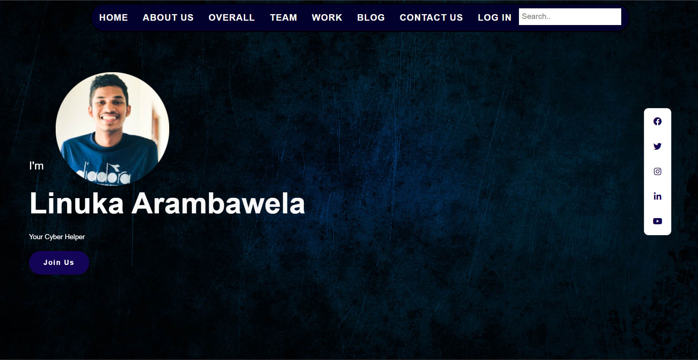
Theme
Personal/blog
A Personal Website for a person who sell his skills.

Slide 3
Technologies
01.
HTML
03.
Php (tried)
02.
Css
04.
Form submit
🎩 🪄

Slide 4
www.formsubmit.co

Slide 5
My code
notification

Slide 6
Need to fix

Slide 7
IT fits😎

Slide 8
BUT!
Navigation bar is not responsive🤨

Slide 9
Working on
01
03
02
Make the search bar work
04
Finish other pages
Make a data base
Host my website

Slide 10
Screenshots

Slide 11
Development of my skils
70
60
60
35
40
10
Html
Css
Hosting/domains
Before
after

Slide 12
Thank you aiya ❤️

Slide 13
Thank you !

